Slide 1
Week 12 Notes
PHY495: Hoop Never Misses

Slide 2
What I’ve Done
Ran test_points.py for 10 point backboard
Worked on presentation

Slide 3
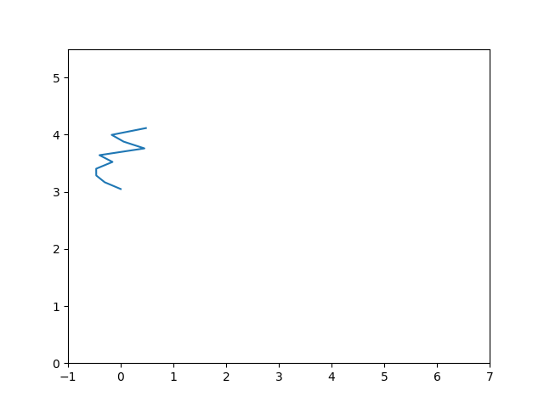
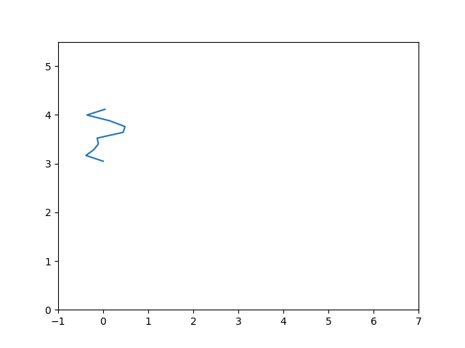
What Worked
Tried the code I had for a 10 point backboard to see if it would work → it extended to 10 points easily but took 10+ hours to get each of these two backboards, which had 100 random backboards and 100 initial shots

Slide 4
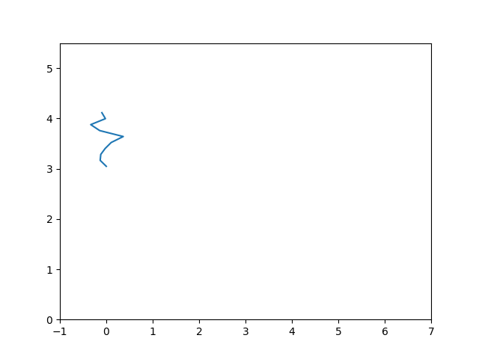
10 point backboard, 100 backboards, 1000 shots, 0.064 percent in

Slide 5
What Didn’t Work
For the 10 point backboard, running 1000 random backboard configurations and 1000 random shots timed out at 40 hours

Slide 6
What Next
Find the optimum backboard for 10 point backboard
Extend to more than 10 points
Introduce energy lost when hitting the backboard?
Extend to 3D

